Slide 1


Jenkins Pipeline for CI/CD.
Presented By: Shubham Saini
Notes:
Note: First “Right Click” on the Gradient background, go to “Order” option and “Send it to Back”, then insert your picture into “Image Placeholder”, “Right Click” on the picture and again go to “Order” option and “Send it to Back” to get the “Gradient” effect.

Slide 2

Our Agenda
01
Creating a Jenkins pipeline to deploy applications present at : https://github.com/knoldus/node-hello
02
Required command to run the application & the ports being are present in the Github repository.
03
Jenkins Freestyle project should be set to this pipeline.
04
Jenkins should be set up on a Cloud Virtual Machine and not from the local system.

Slide 3
Our Agenda
05
Any commits to the ‘main’ branch should trigger the job on Jenkins and start the build process.
06
Use Poll SCM triggers
07
Implementation of Global tools Comfiguration to use NodeJS effectively.
08
The validations can be performed by hitting endpoints for ports 3000 or 3001.

Slide 4
Requirements
01
Jenkins Should be on any cloud service(eg: Google Cloud or AWS).
02
Any commit to the main branch should trigger the job on jenkins & start the build process.
03
Use Poll SCM triggers
04
The first of the jenkins job should be creating the package.
05
The second part of the jenkins job will be to send the package to another VM & run it there.

Slide 5
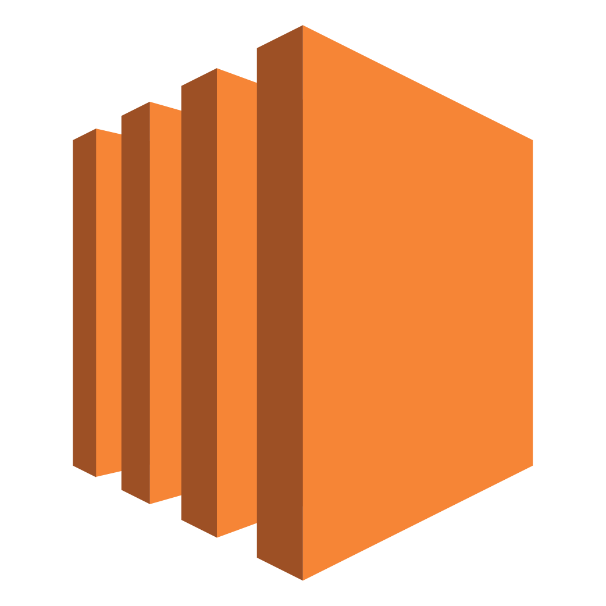

Introduction
AWS EC2
Jenkins
Amazon Elastic Compute Cloud is a part of Amazon.com's cloud-computing platform, Amazon Web Services, that allows users to rent virtual computers on which to run their own computer applications.
Jenkins is a free and open source automation server. It helps automate the parts of software development related to building, testing, and deploying, facilitating continuous integration and continuous delivery. It is a server-based system that runs in servlet containers such as Apache Tomcat.

Slide 6
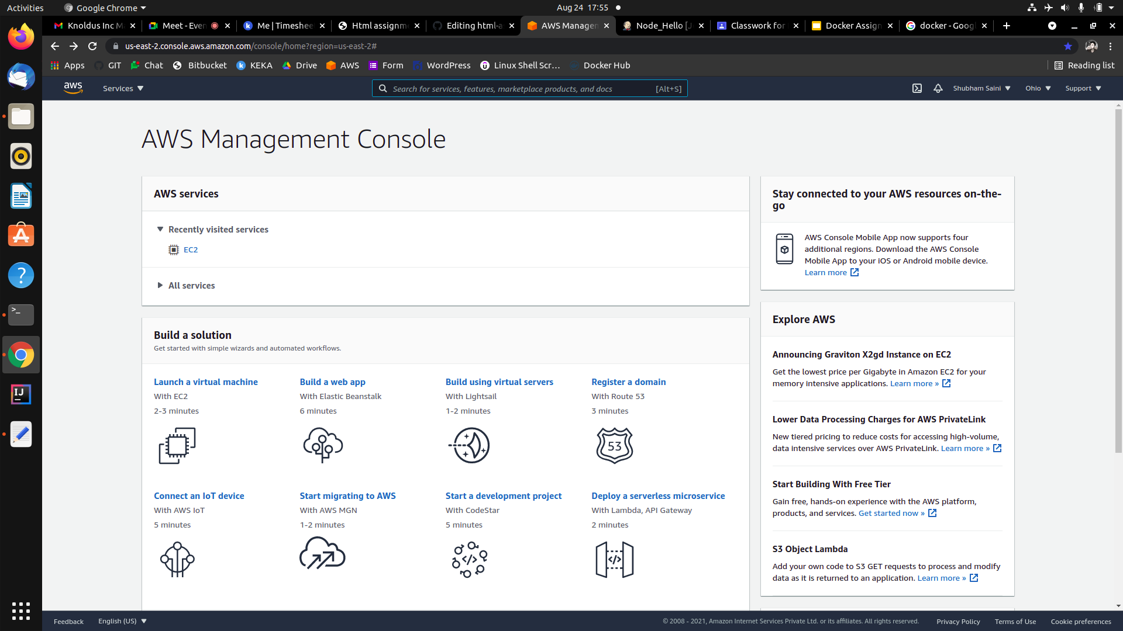
AWS EC2 Server
Using AWS EC2 server

Slide 7
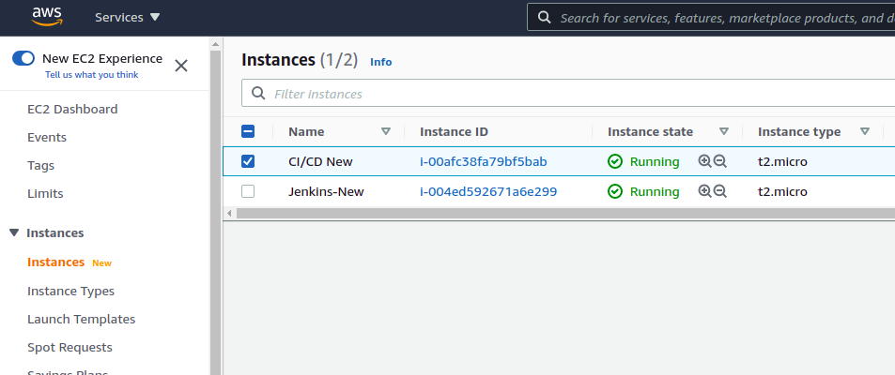
Creating an Instance on EC2 server to connect with it using public IP
Instance for connecting Jenkins pipeline
Instance on EC2 server

Slide 8
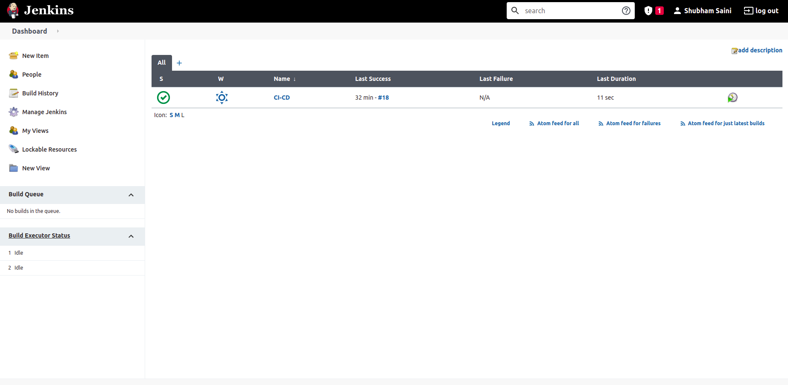
Jenkins on Cloud Virtual Machine
Instance for connecting Jenkins pipeline
Jenkins on Cloud Virtual Machine.

Slide 9
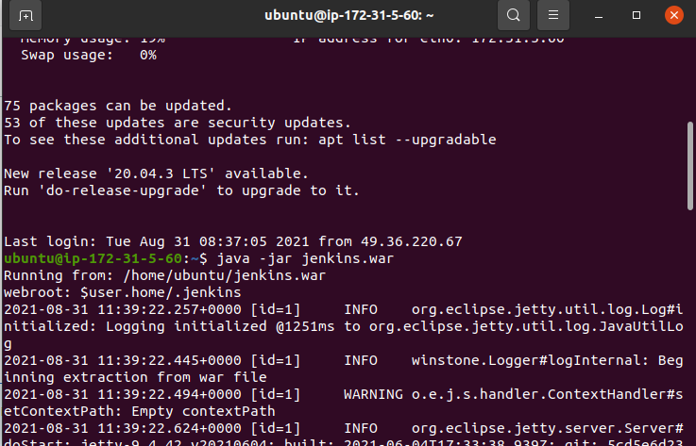
Accessing Instance by Local System
Accessing the Instance through local system
Accessing Instance on local System.
Accessed our instance

Slide 10
Running Jenkins
Running jenkins

Slide 11
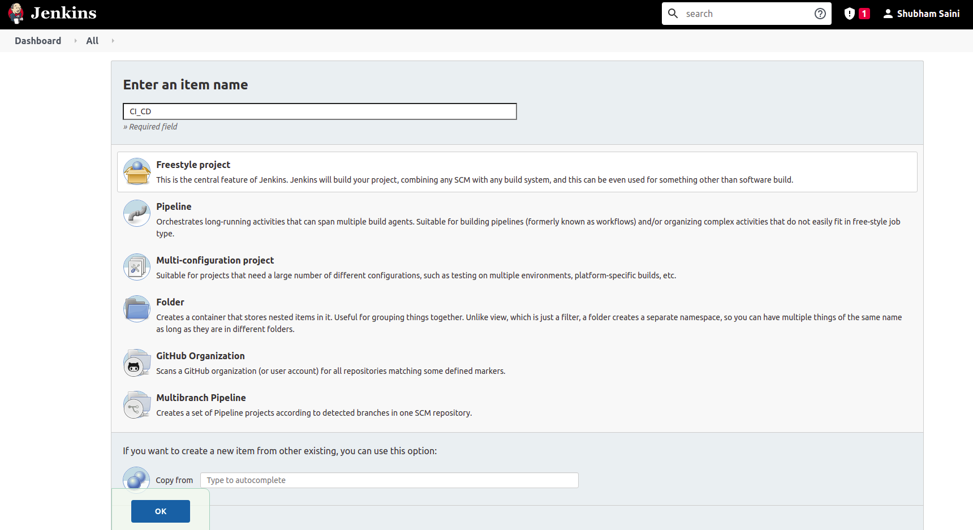
Creating Project on Jenkins
Creating a freestyle project on jenkins
Creating a free style project.

Slide 12
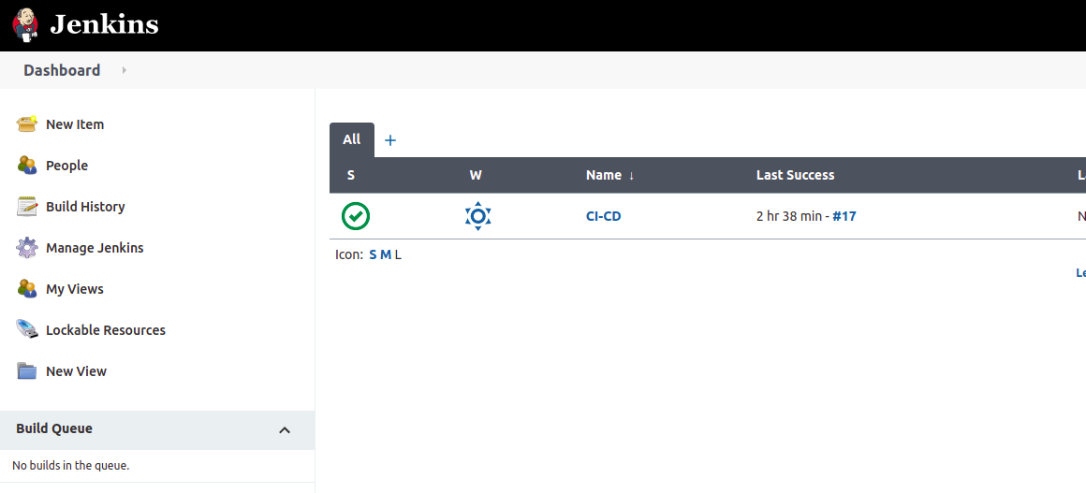
Project on Jenkins
Your subtitle will be here

Slide 13
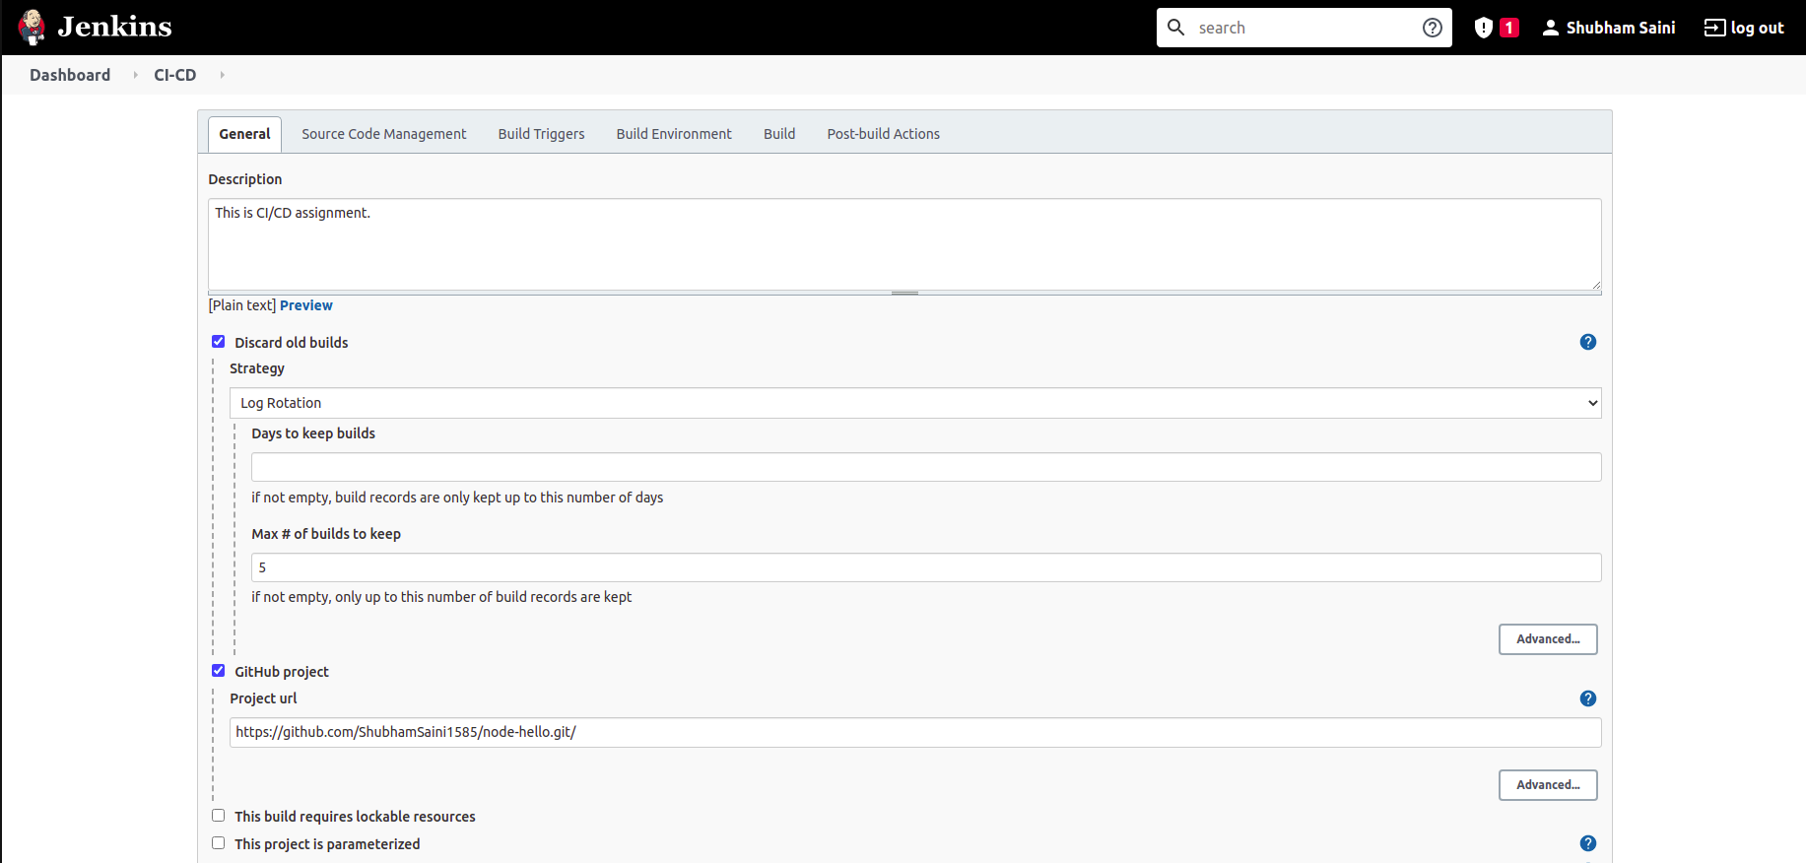
Pipeline Configuration

Slide 14
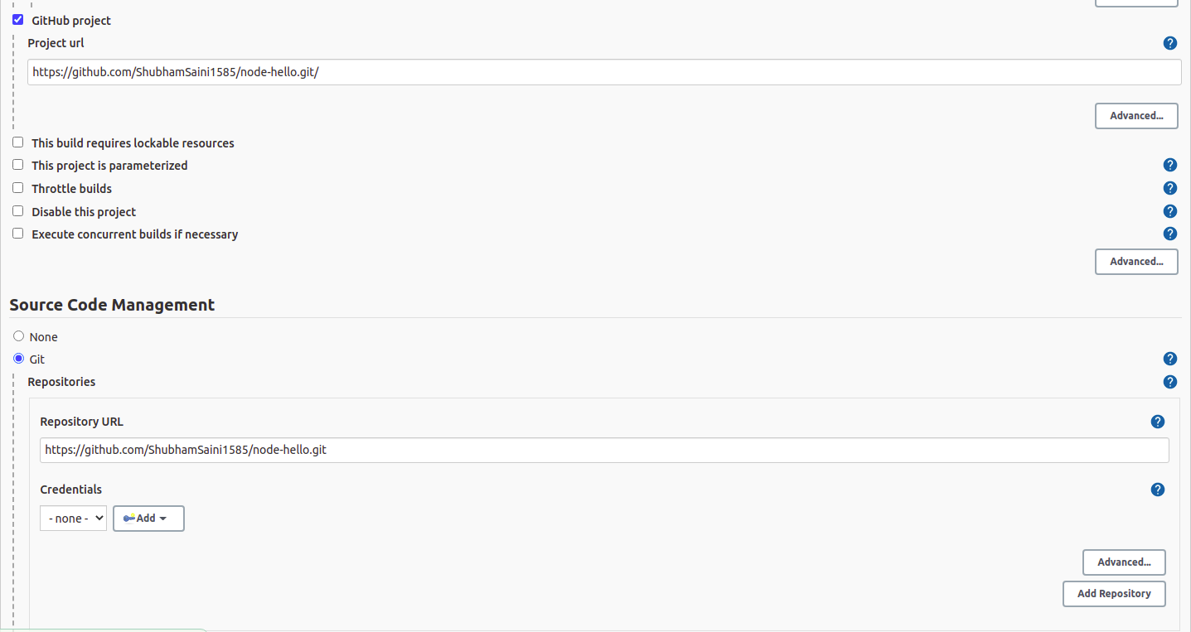
Adding Git of the forked Git Repository
Forked the link https://github.com/knoldus/node-hello
Git Link to deploy the application present there.

Slide 15
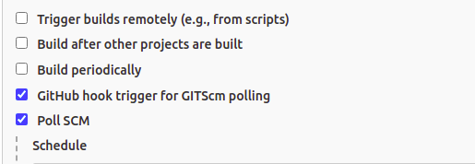
Configuring Triggers in the project
Using Poll SCM

Slide 16
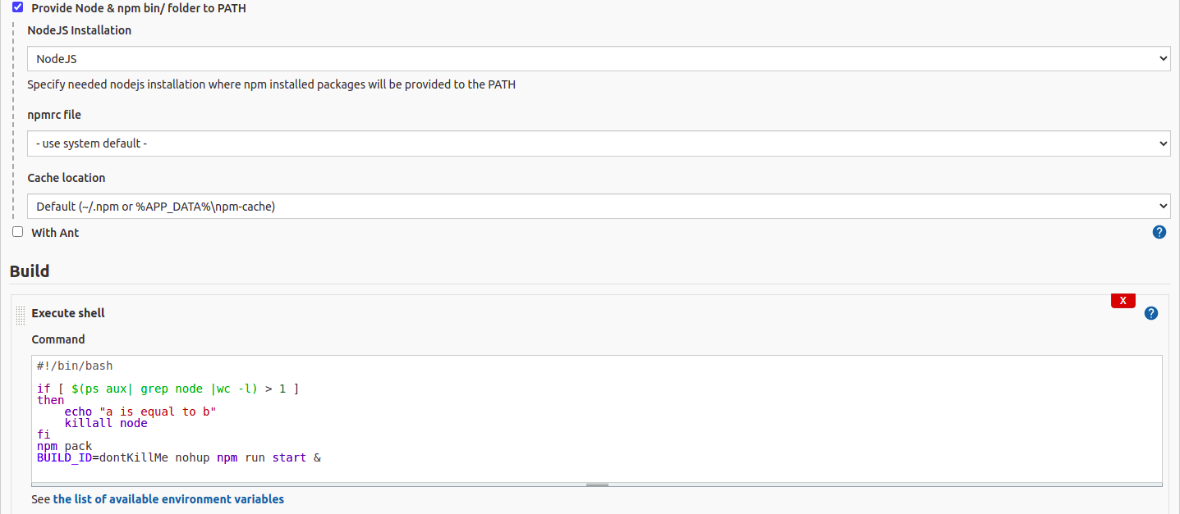
Adding NodeJS path & Execute Shell

Slide 17
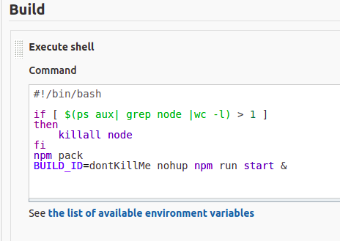
Adding script in the Execute shell
Freeing up the ports acquired by another Instances.

Slide 18
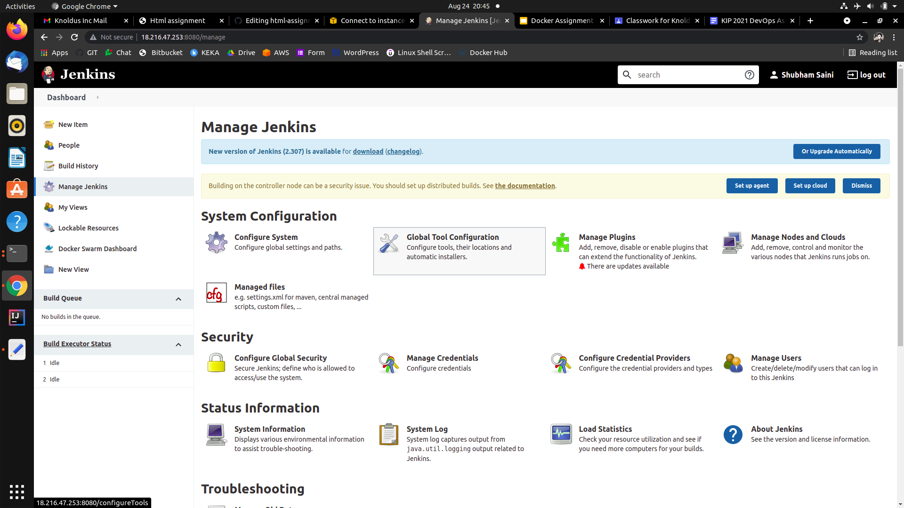
Configuring Global Environment

Slide 19
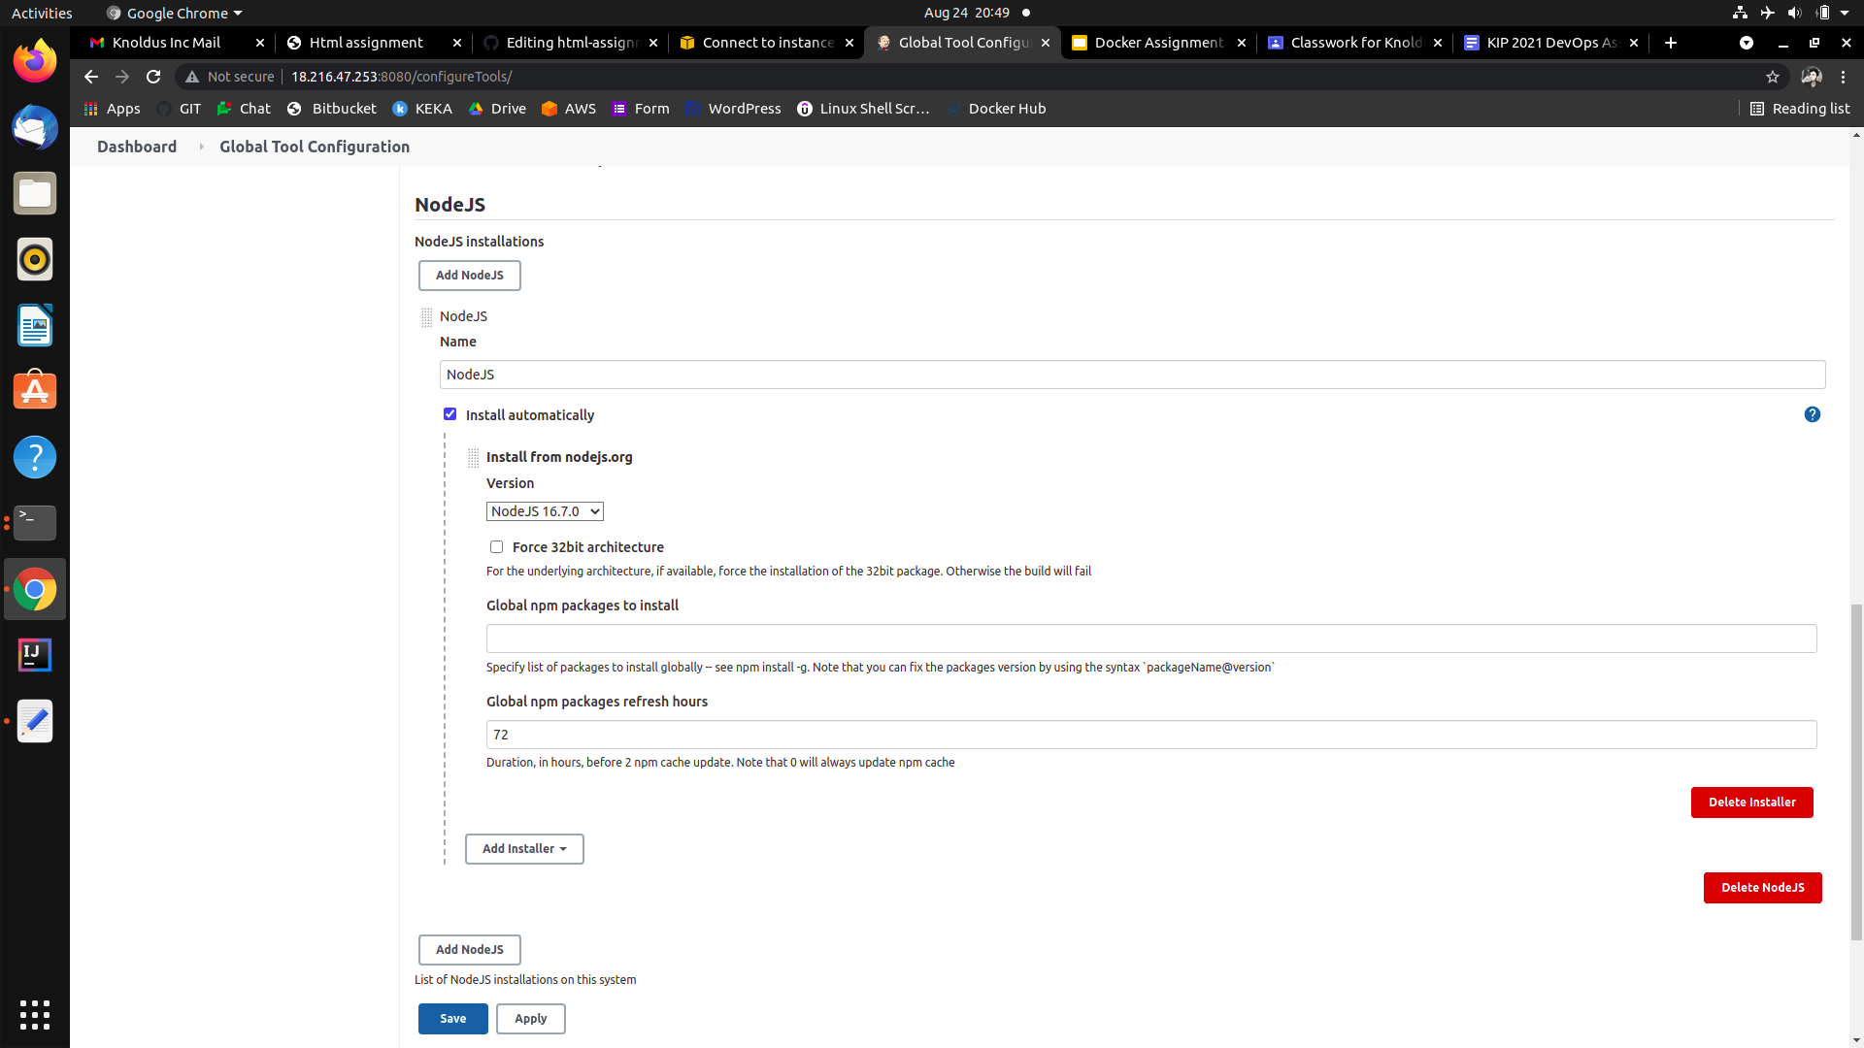
NodeJS Configuration Global Environment

Slide 20
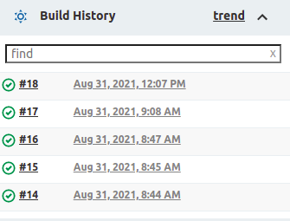
Builds After Committing on the Main Branch
Build History

Slide 21
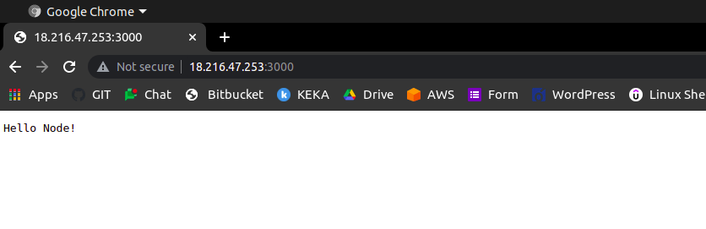
Validation by hitting endpoints: <VM_IP>:3000
Working on port number 3000

Slide 22

Validation by hitting endpoints: <VM_IP>:3001
Working on port number 3001

Slide 23
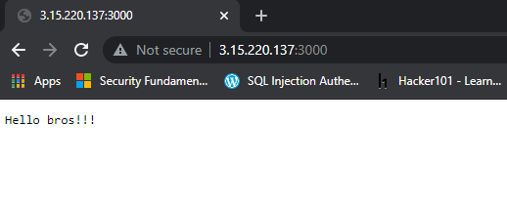
Accessing the port: 3000 on Another VM
Working on port number 3000

Slide 24
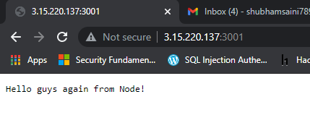
Accessing the port: 3001 on Another VM
Working on port number 3000

Slide 25
Thank You!
Notes:
Note: First “Right Click” on the Gradient background, go to “Order” option and “Send it to Back”, then insert your picture into “Image Placeholder”, “Right Click” on the picture and again go to “Order” option and “Send it to Back” to get the “Gradient” effect.

